Slide 1

DIGITAL MARKETING PROJECT PHASE 2

Slide 2

BRAND RESEARCH ON WIPRO
WIPRO’S FULL NAME IS
Western India Palm Refined Oils Limited
TEAM ID:LTVIP2023TMID10342
TEAM LEAD:CHINTU SHARMILA
MEMBERS:CHINTAMA JHANSI
DUPPALA LEELA RANI
DUGANA SIREESHA
DUMPA SAI LAXMI

Slide 3
WIpRO BRAND STUDY
Wipro is an Indian multinational corporation that provides information technology, consulting, and business process services. The company was founded in 1945 and has since become one of India's largest IT services companies. Wipro has a strong global presence and offers a wide range of services, including IT consulting, application development, infrastructure management, and business process outsourcing.

Slide 4
VALUES AND USP OF WIPRO
1.VALUES OF WIPRO: USP OF WIPRO
1.INTEGRITY. 1.GLOBAL PRESENCE
2.CUSTOMER CENTRICITY. 2.INNOVATIVE SOLUTIONS
3.INNOVATION. 3.SUSTAINABILITY
4.PASSION FOR EXCELLENCE 4.TALENT POOL
5.TEAMWORK 5.VERTICAL EXPERTISE

Slide 5
BRAND TONE AND IDENTITY
Wipro's brand is characterized by a professional, innovative, and customer-centric tone. It positions itself as a global leader in the IT industry, emphasizing its commitment to sustainability, cultural diversity, and excellence. The brand identity is closely tied to a technology-driven, innovative approach, a strong global presence, corporate responsibility, and a focus on customer satisfaction. This combined image portrays Wipro as a trustworthy, forward-thinking, and socially responsible partner in the IT services and consulting sector.

Slide 6
SMART GOALS AND KPI’s OF WIPRO
1. Revenue Growth:
Goal: Achieve a 10% increase in annual revenue.
KPI: Annual revenue figures compared to the previous year.
2. Customer Satisfaction:
Goal: Maintain a customer satisfaction score of 90% or higher.
KPI: Regular customer surveys and feedback scores.
3. Employee Development:
Goal: Increase the percentage of employees completing annual training and development programs by 20%.

Slide 7
SMART GOALS AND KPI’s OF WIPRO
KPI: Percentage of employees completing training and development programs.
4. Sustainability and Environmental Impact:
Goal: Reduce carbon emissions by 15% by the end of the fiscal year.
KPI: Tracking of carbon emissions and sustainability initiatives.
5. Market Expansion:
Goal: Enter two new emerging markets in the Asia-Pacific region within the next 12 months.
KPI: Successful market entry, measured by market penetration and revenue generated.

Slide 8
COMPETITOR ANALYSIS AND BUYER’s AUDIENCE PERSONA
Wipro primarily targets a diverse set of B2B (business-to-business) clients, spanning various industries and geographic locations. While specific client profiles can vary, the typical target audience for Wipro's brand can be defined as follows:
Demographics:
Large to medium-sized enterprises.
Multinational corporations.
Businesses across various sectors, such as healthcare, finance, technology, retail, and more.

Slide 9
COMPETITOR ANALYSIS AND BUYER’s AUDIENCE PERSONA
Psychographics:
Organizations seeking innovative and cutting-edge technology solutions.
Clients looking for long-term partnerships and customized services.
Companies with a global outlook, interested in international business expansion.

Slide 10
COMPETITOR ANALYSIS AND BUYER’s AUDIENCE PERSONA
Behaviors:
Clients looking for end-to-end IT services, from consulting to implementation.
Organizations focused on digital transformation and enhancing their technological capabilities.
Companies seeking to outsource IT and business process functions to improve efficiency and reduce costs.

Slide 11
COMPETITOR ANALYSIS AND BUYER’s AUDIENCE PERSONA
Interests:
Interest in technology innovation and digital solutions.
A preference for long-term partnerships and collaborative working relationships.
Concern for environmental sustainability and corporate responsibility practices.

Slide 12
COMPETITOR ANALYSIS AND BUYER’s AUDIENCE PERSONA
COMPETITOR | USP(UNIQUE SELLING PROMOTION) | ONLINE COMMUNICATION | SWOT ANALYSIS
TCS(TATA CONSULTANCY SERVICES) | TCS is known for its strong global presence, extensive experience in IT services, and a wide range of services including consulting, business solutions, and IT outsourcing. | TCS has a robust online presence, providing thought leadership through blogs, whitepapers, and webinars. | Strengths - Global reach, diverse service offerings; Weaknesses - Intense competition, size may slow decision-making; Opportunities - Digital transformation, emerging markets; Threats - Data security concerns, economic downturns.

Slide 13
COMPETITOR ANALYSIS of wipro
COMPETITOR | USP(UNOQUE SELLING PROMOTION) | ONLINE COMMUNICATION | SWOT ANALYSIS
Infosys | Infosys is recognized for its focus on innovation and digital services, including artificial intelligence, blockchain, and cloud solutions. | Infosys maintains a strong online presence through informative articles and webinars on emerging technologies. | Strengths - Innovation-driven, strong client relationships; Weaknesses - Heavy reliance on North America, high employee turnover; Opportunities - Digital disruption, expanding into new industries; Threats - Data privacy regulations, competition from startups.
Cognizant | Cognizant is known for its industry-specific solutions and expertise in areas like healthcare, financial services, and technology. | Cognizant focuses on industry-focused content, including reports, case studies, and industry insights. | Strengths - Industry expertise, tailored solutions; Weaknesses - Overdependence on a few clients, attrition; Opportunities - Digital healthcare, AI in financial services; Threats - Industry-specific regulations, economic uncertainties.

Slide 14
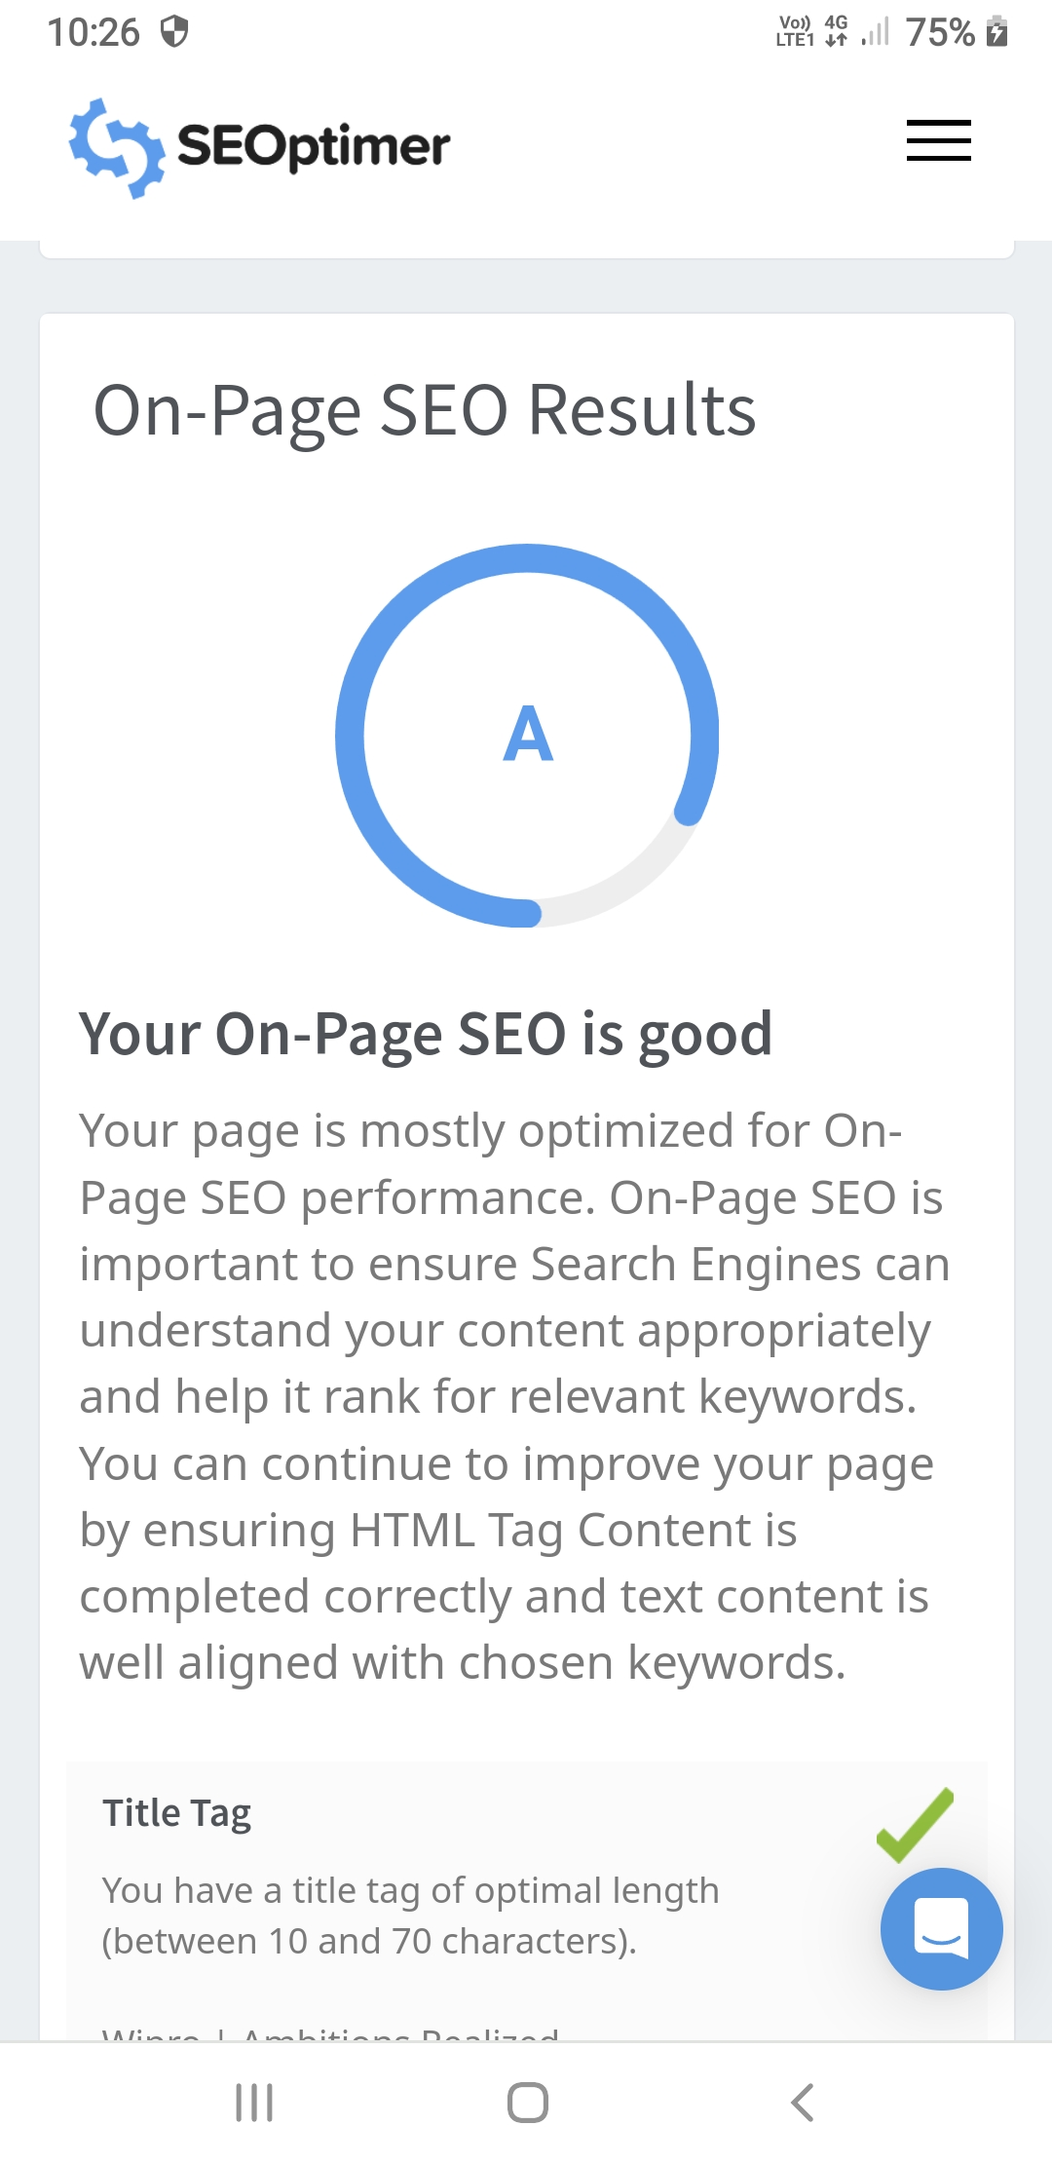
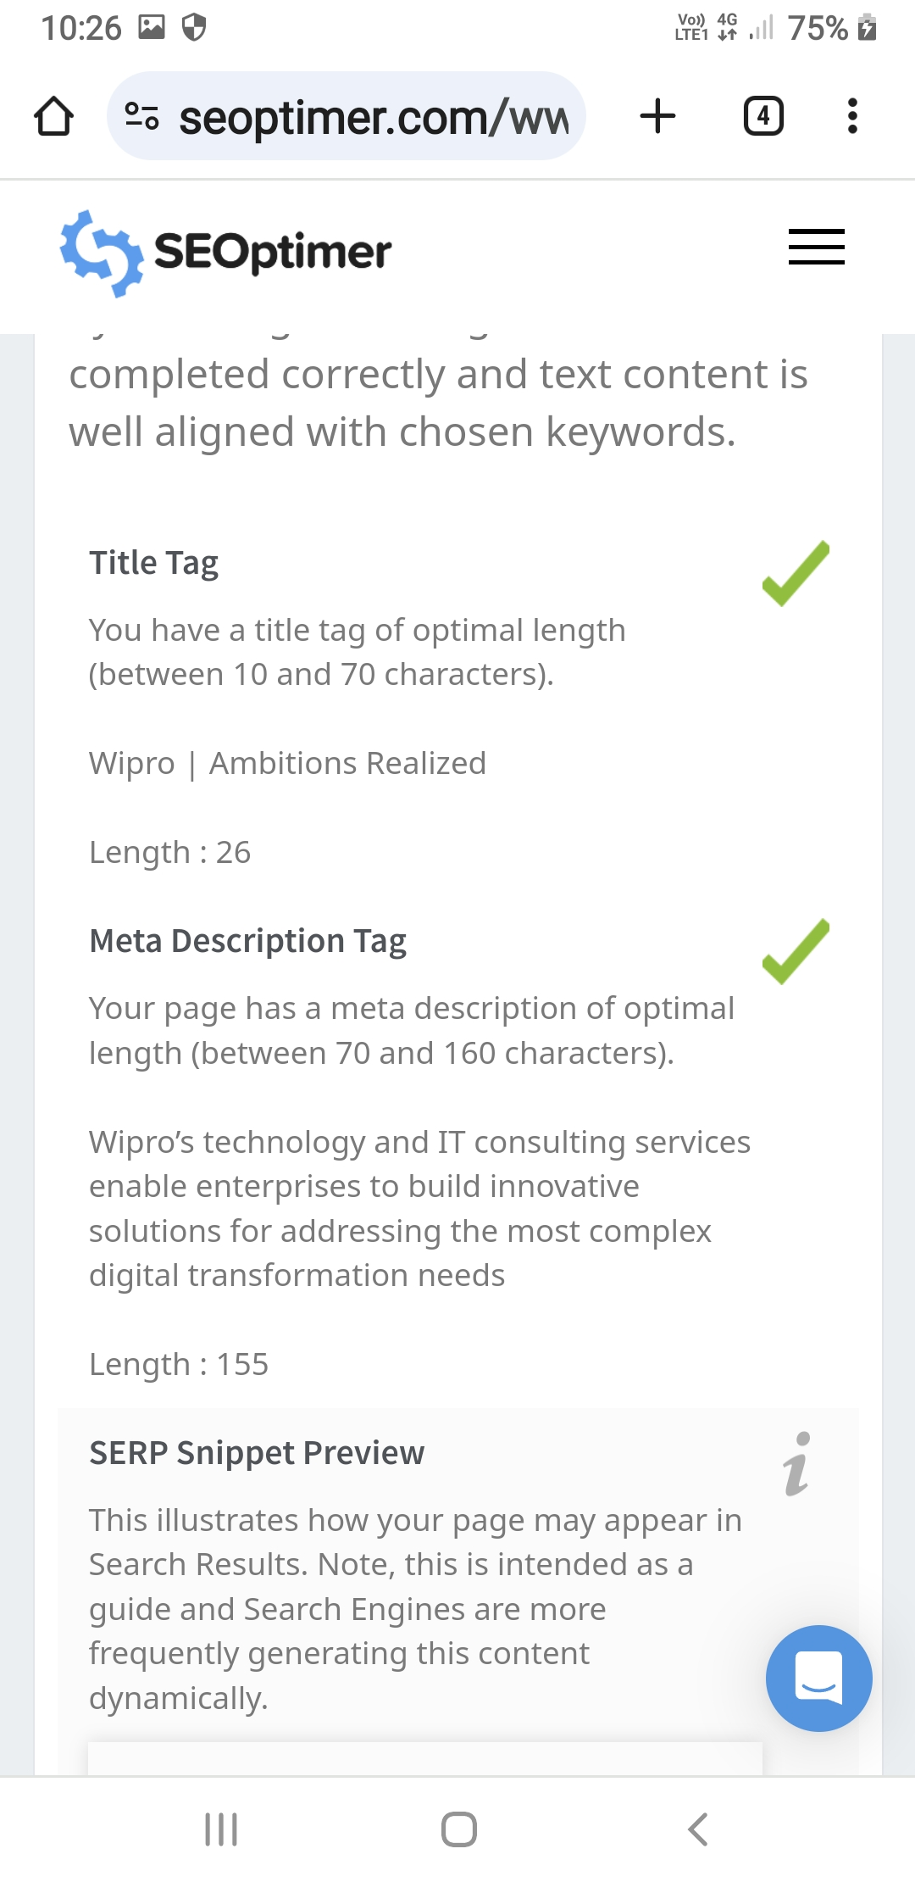
SEO AND KEYWORD RESEARCH
SEO AUDIT:

Slide 15
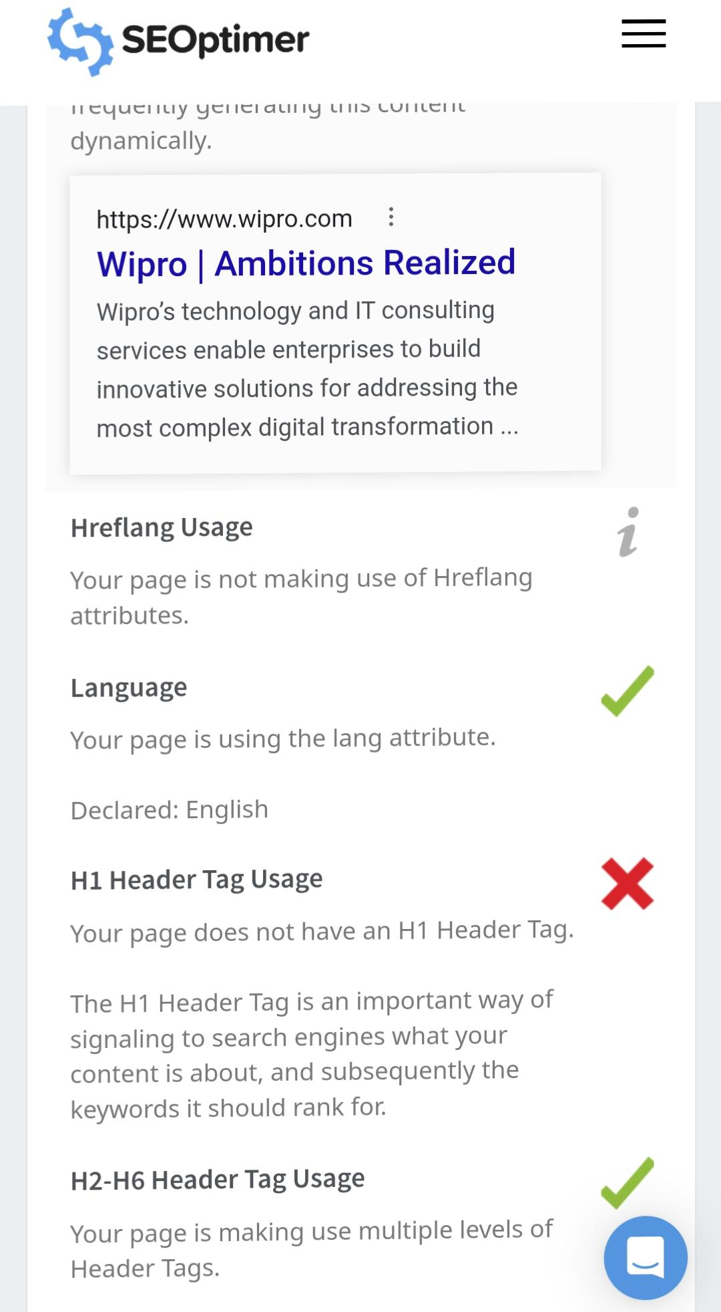
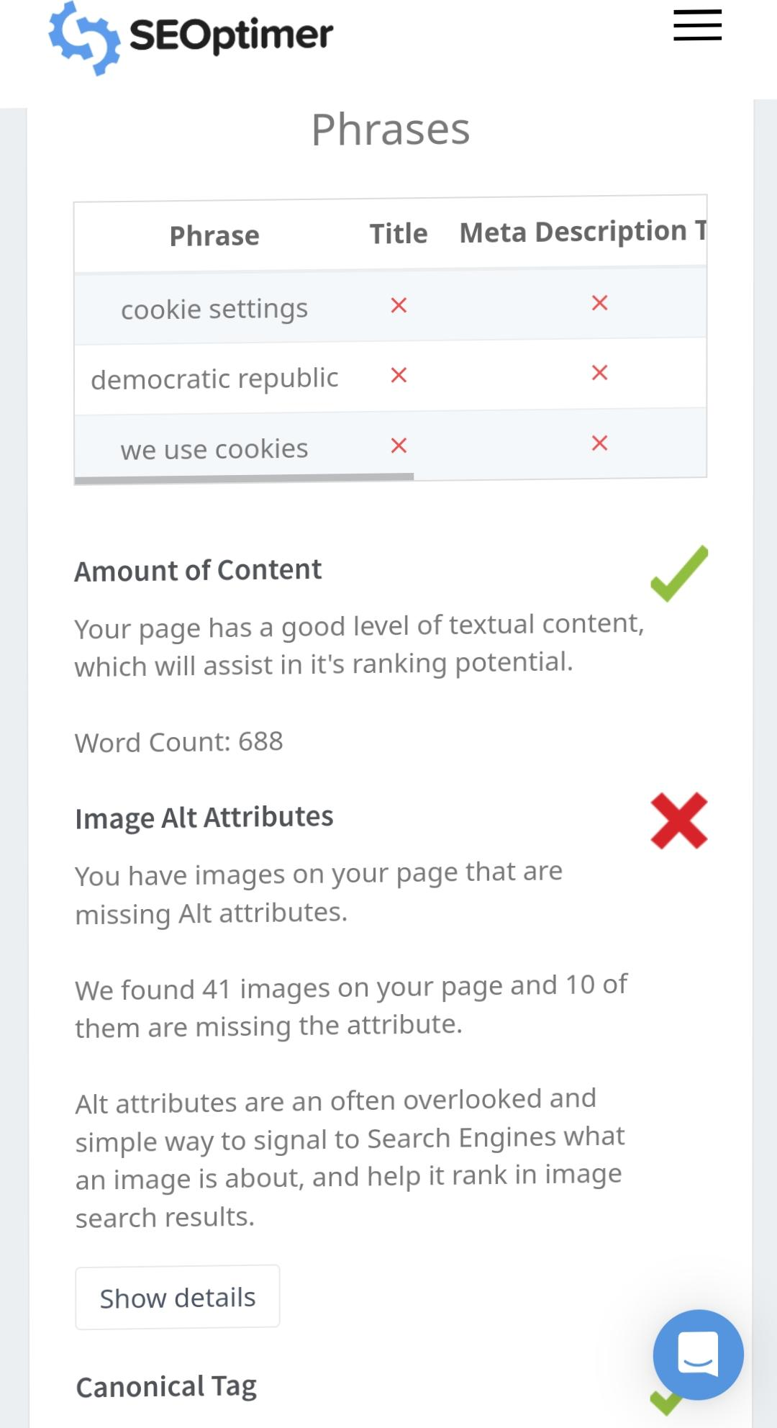
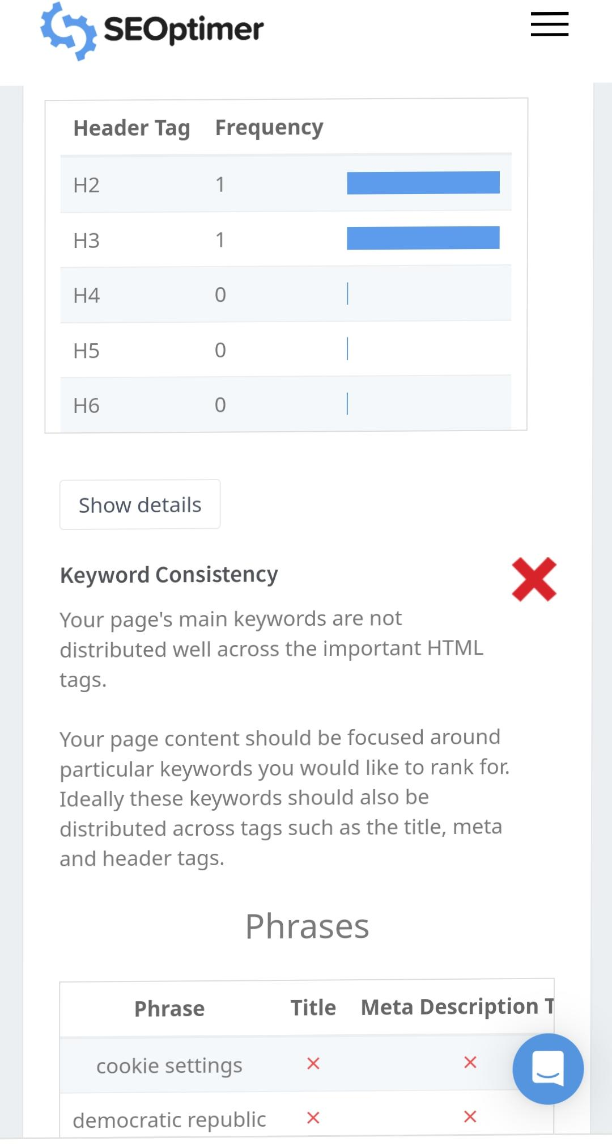
SEO AND KEYWORD RESEARCH

Slide 16
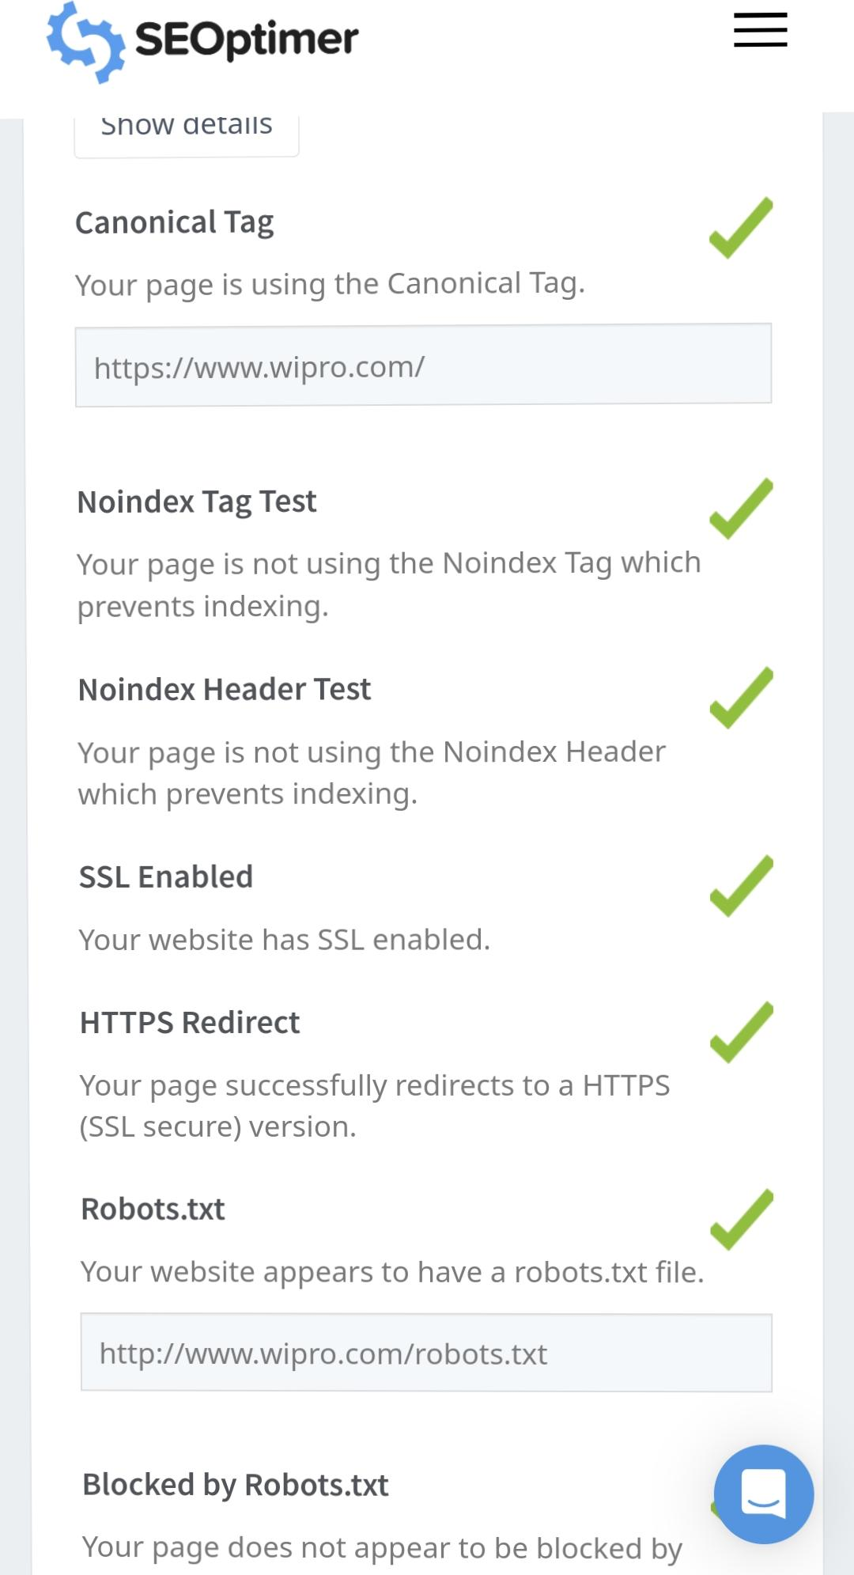
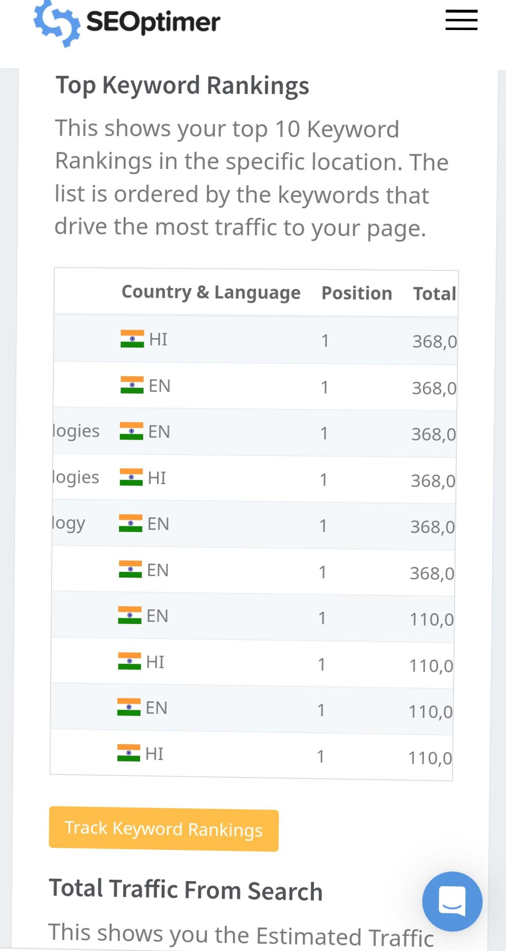
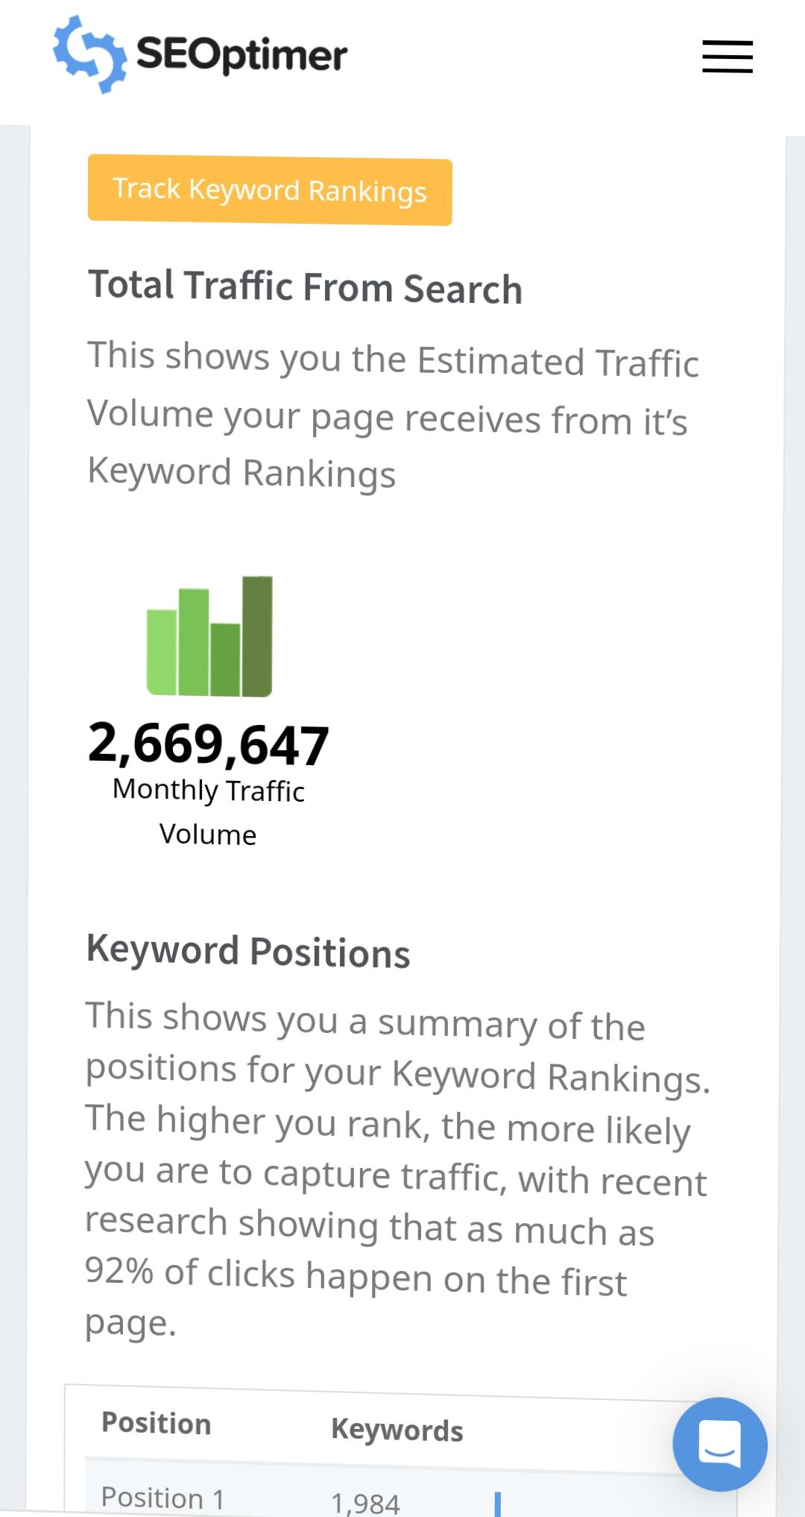
SEO AND KEYWORD RESEARCH

Slide 17
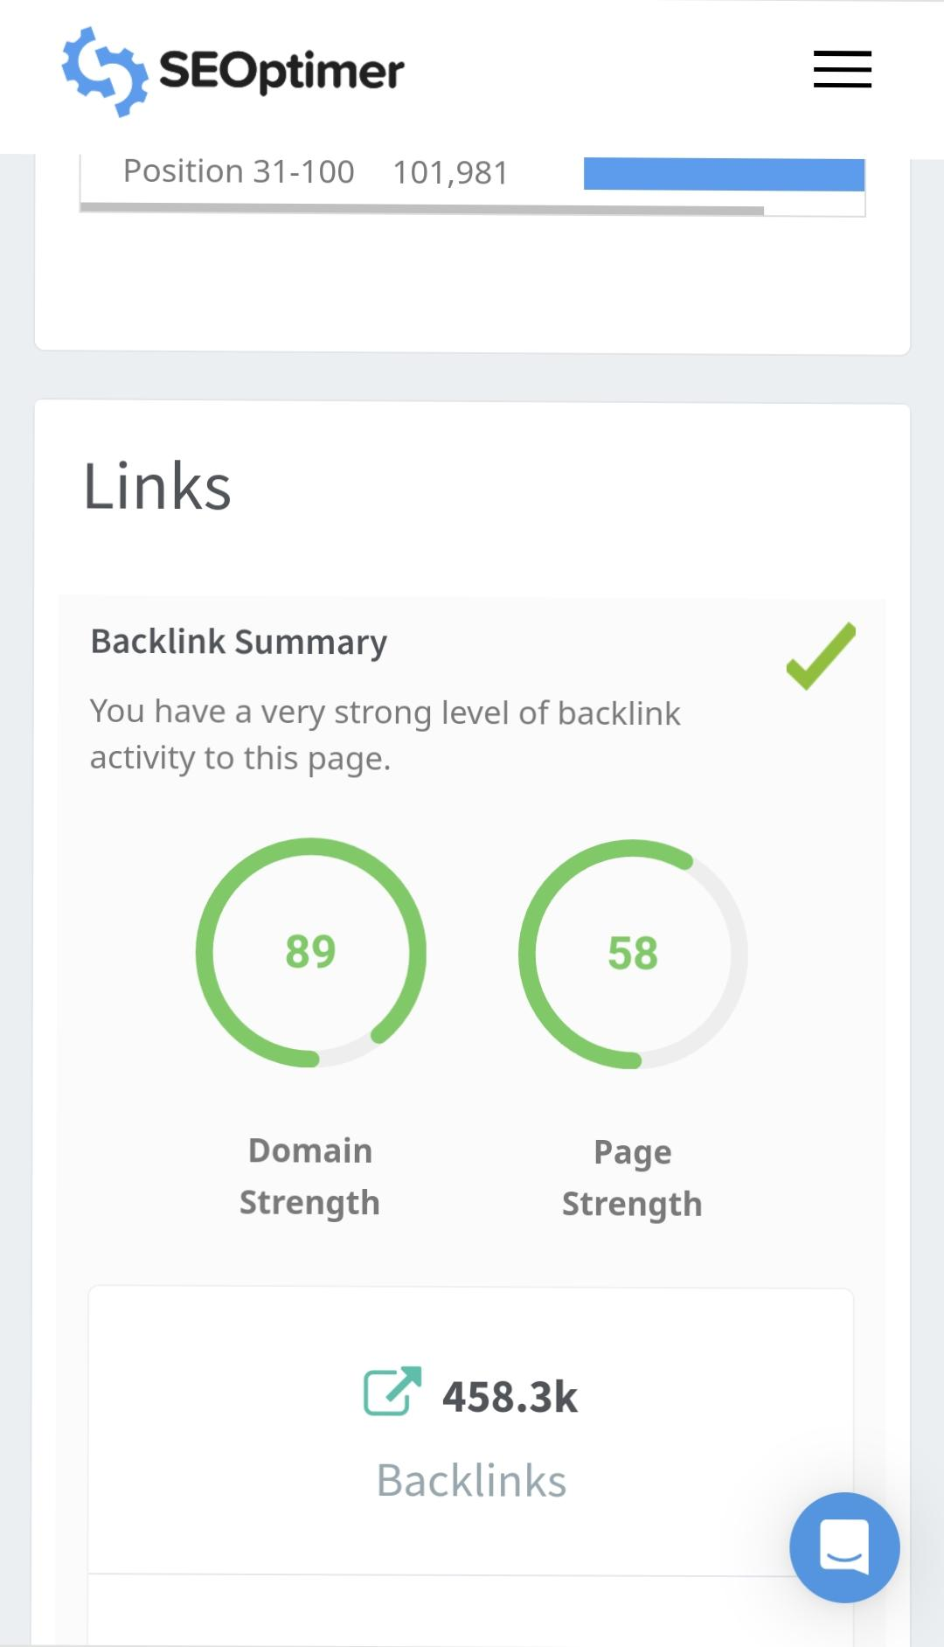
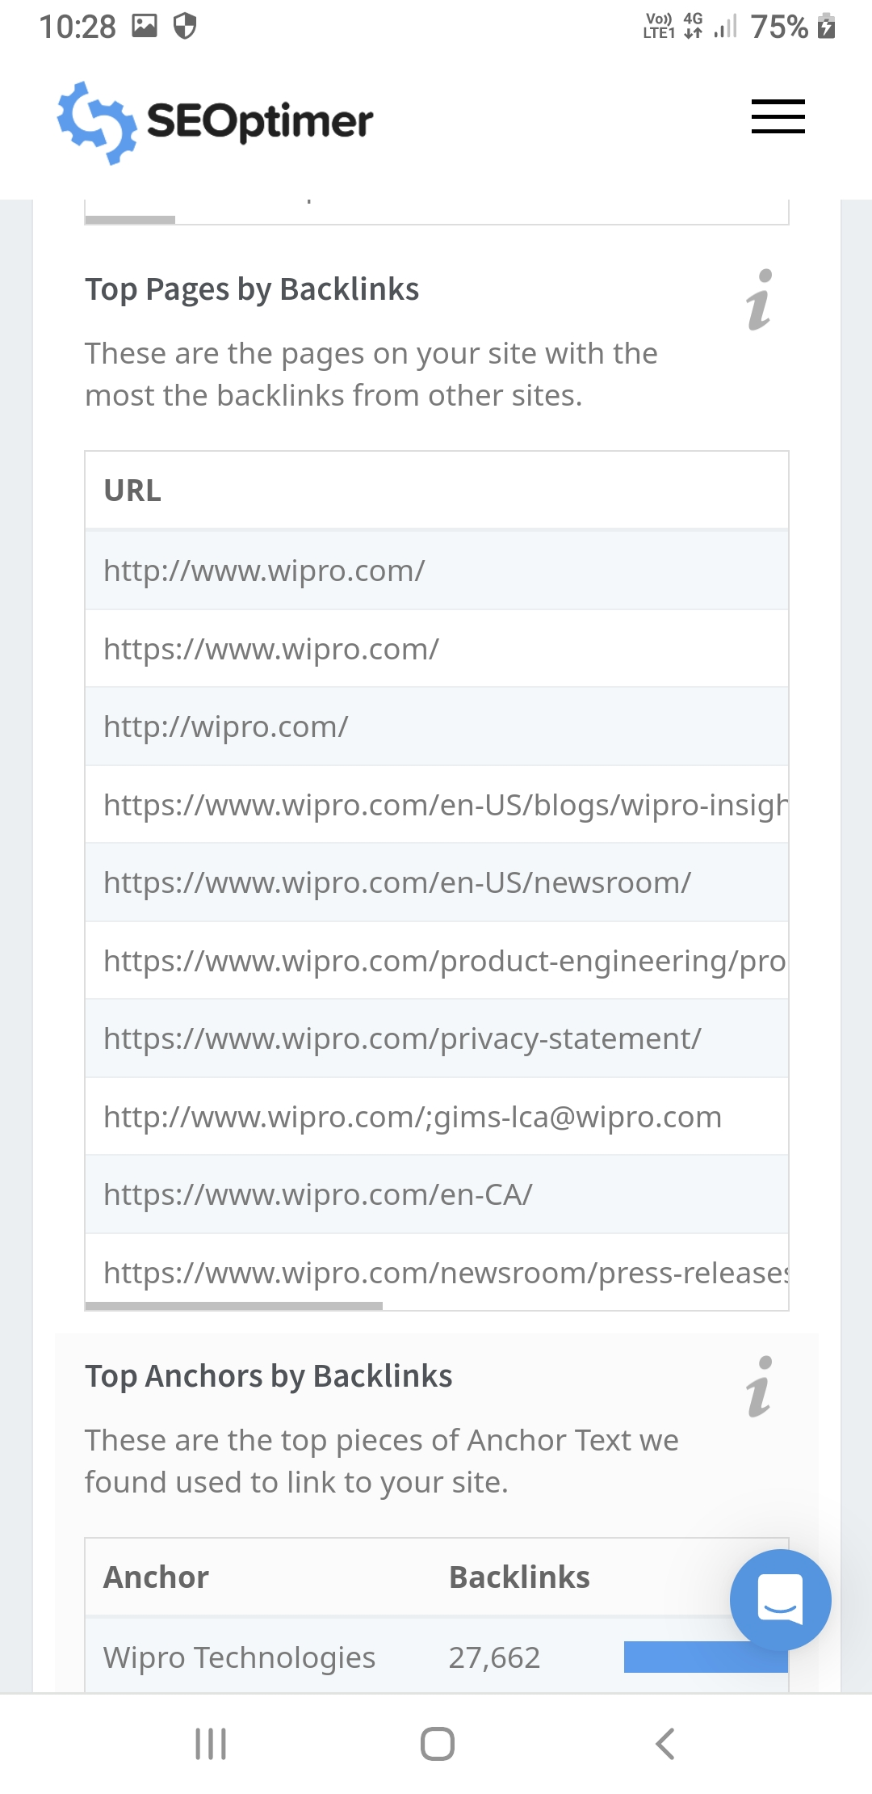
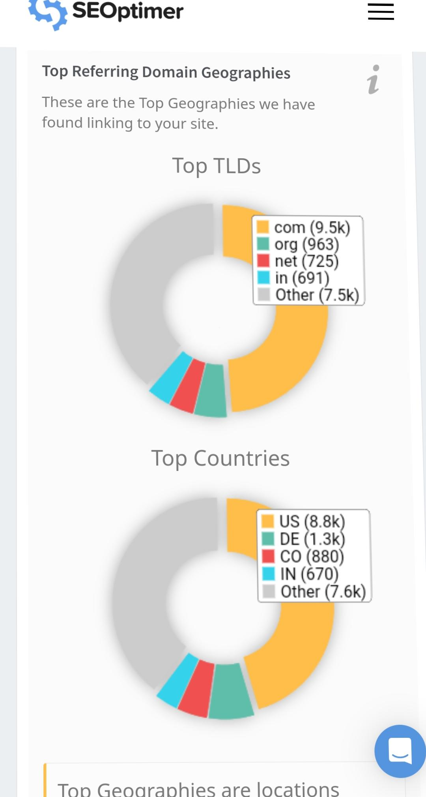
SEO AND KEYWORD RESEARCH
SEO AND KEYWORD RESEARCH

Slide 18
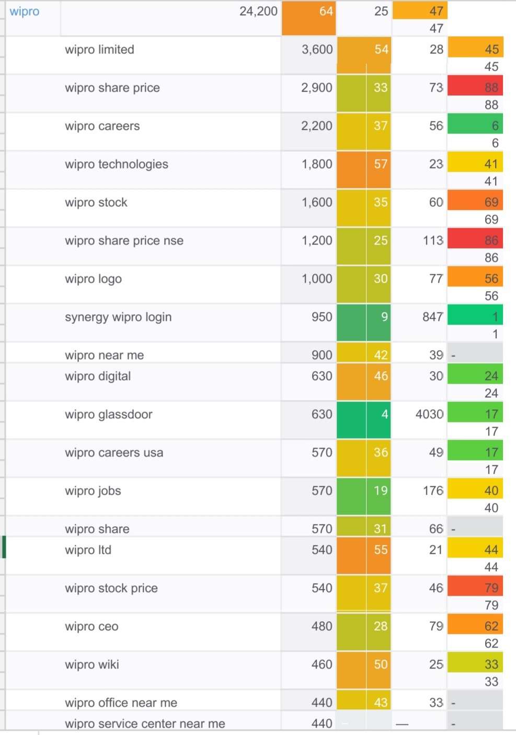
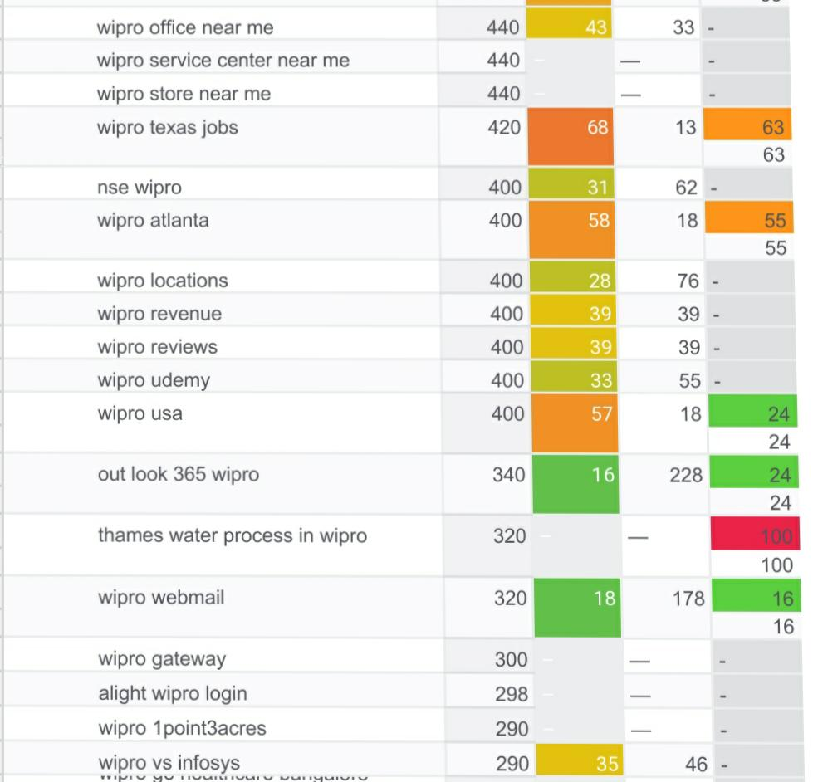
KEYWORD RESEARCH OF WIPRO
SOME OF THE IMPORTANT KEYWORDS OF WIPRO:

Slide 19
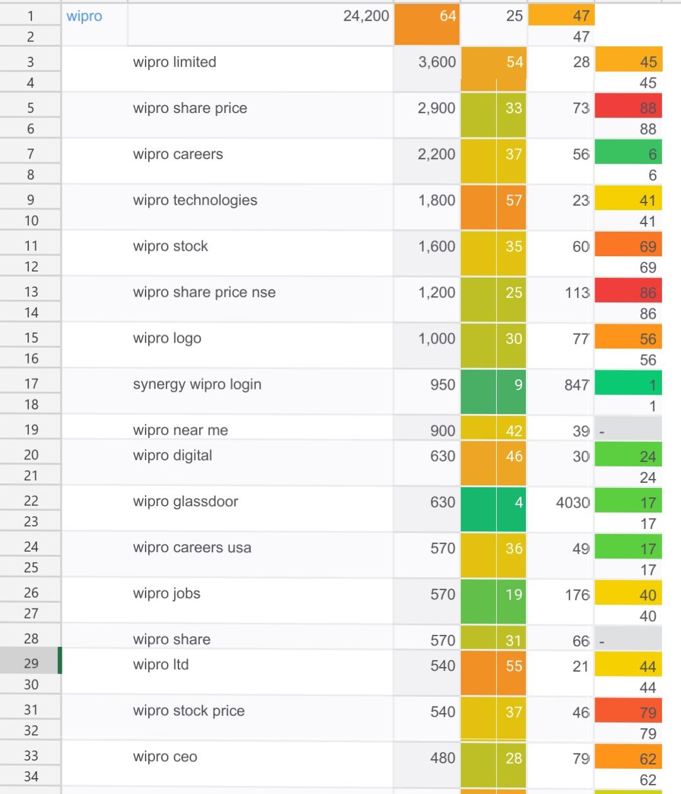
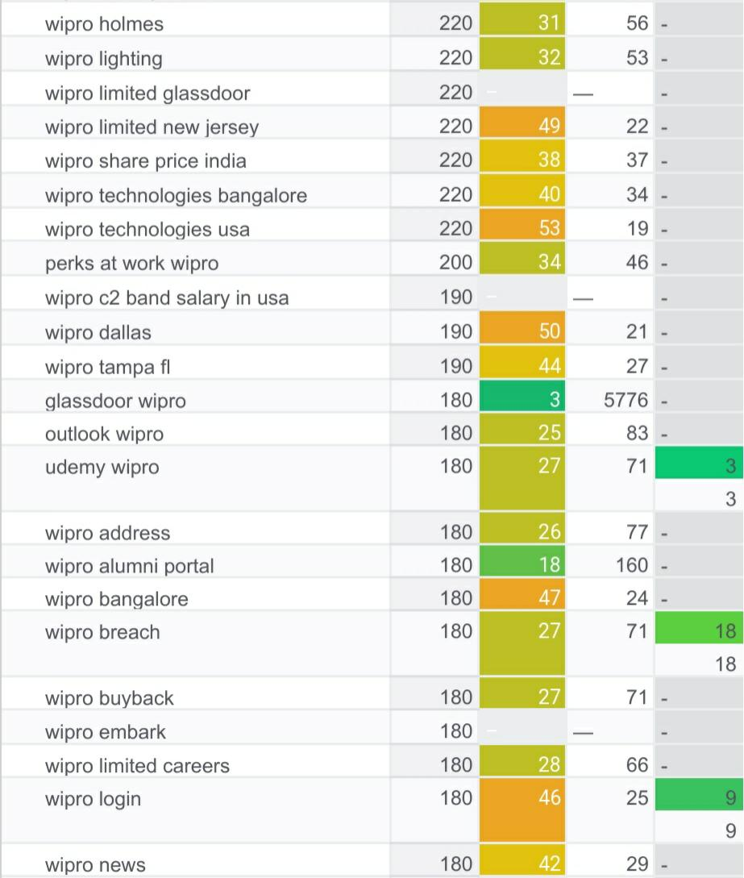
KEYWORD RESEARCH OF WIPRO

Slide 20
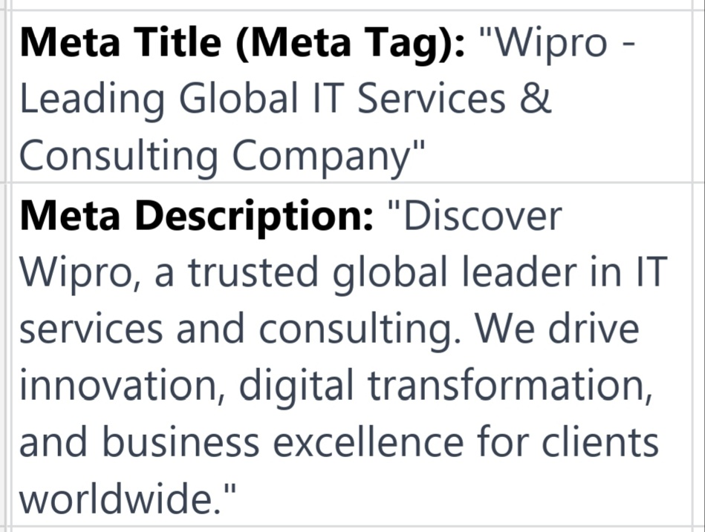
Meta tags and description
META TAGS AND META DESCRIPTION:

Slide 21
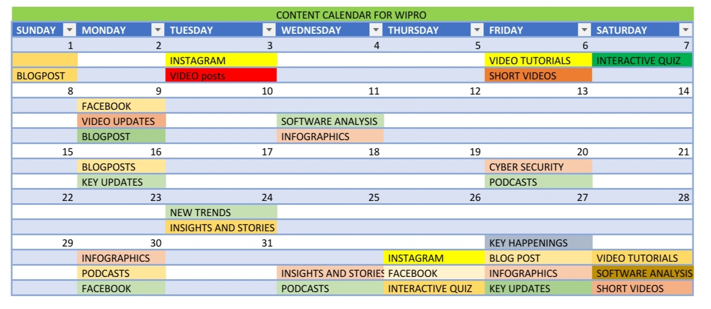
CONTENT CALENDER OF WIPRO

Slide 22
CONTENT IDEAS OF WIPRO
Content Ideas for Wipro:
Industry Reports: Publish reports on emerging trends and challenges in the IT and consulting industry.
Client Success Stories: Share case studies showcasing how Wipro helped clients achieve their goals.
Thought Leadership Blogs: Explore topics like AI, cybersecurity, and digital transformation.
Video Webinars: Host webinars featuring Wipro experts discussing industry topics.

Slide 23
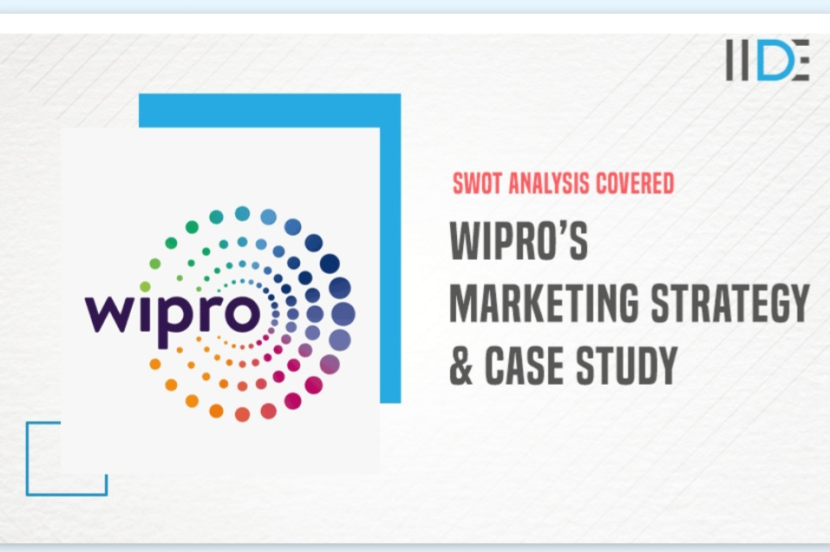
MARKETING STRATEGIES OF WIPRO

Slide 24
MARKETING STRATEGIES OF WIPRO
Wipro, like many large IT and consulting companies, employs a variety of marketing strategies to reach its target audience and promote its services.
Digital Marketing: Leveraging online channels, such as the company's website, social media platforms, and email marketing, to connect with clients and prospects. This includes content marketing, search engine optimization (SEO), and pay-per-click advertising.
Content Marketing: Creating valuable and informative content like blog posts, whitepapers, videos, and infographics to establish thought leadership and engage with the audience.

Slide 25
MARKETING STRATEGIES OF WIPRO
Client Case Studies: Highlighting successful projects and collaborations with clients to demonstrate Wipro's capabilities.
Innovation and R&D: Promoting cutting-edge technologies and innovations to demonstrate the company's commitment to staying at the forefront of the industry.
Partnerships and Alliances: Collaborating with other companies, platforms, and technologies to enhance service offerings.
Employee Advocacy: Encouraging employees to be brand advocates and share their experiences and insights.

Slide 26
CHALLENGES ENCOUNTERED AND LESSONS LEARNED
Challenges Encountered:
Content Consistency: Maintaining a consistent publishing schedule can be challenging due to the need for high-quality content.
Content Quality: Ensuring that content is not only frequent but also valuable and insightful is crucial.
Audience Engagement: Gaining and retaining the audience's attention can be challenging in a competitive industry.
Measurement and ROI: Tracking the effectiveness of content and demonstrating its ROI is often complex.

Slide 27
Lessons learned from this project
Lessons Learned:
Quality Over Quantity: It's better to produce fewer pieces of high-quality content rather than an abundance of mediocre content.
Audience Segmentation: Tailor content to different audience segments to make it more relevant.
Collaboration: Engage subject matter experts within Wipro to contribute to content.
Consistent Branding: Maintain a consistent visual and messaging brand identity.

Slide 28
Lessons learned from this project
Continuous Learning: The digital landscape evolves rapidly, so staying informed about industry trends and marketing tactics is essential.
Experimentation: Don't be afraid to try new content formats or platforms and measure their effectiveness.
Engage on Social Media: Be active on social platforms, responding to comments and engaging with the audience.

Slide 29
CONTENT CREATION AND CURATION
three different content formats relevant to Wipro, along with researched and brainstormed ideas, complete content/captions, and calls to action (CTAs):
Content Format 1: Industry News Updates
Research and Brainstorm: Industry news is a great way to demonstrate Wipro's expertise and keep the audience informed.
Cybersecurity Trends Content/Caption: "Stay ahead of the game in cybersecurity! 🔒 Discover the latest trends and threats impacting the tech world. Learn more about how Wipro is leading the charge in protecting your digital world. #Cybersecurity #TechTrends" CTA: "Read More" or "Contact Us for Cybersecurity Solutions."

Slide 30
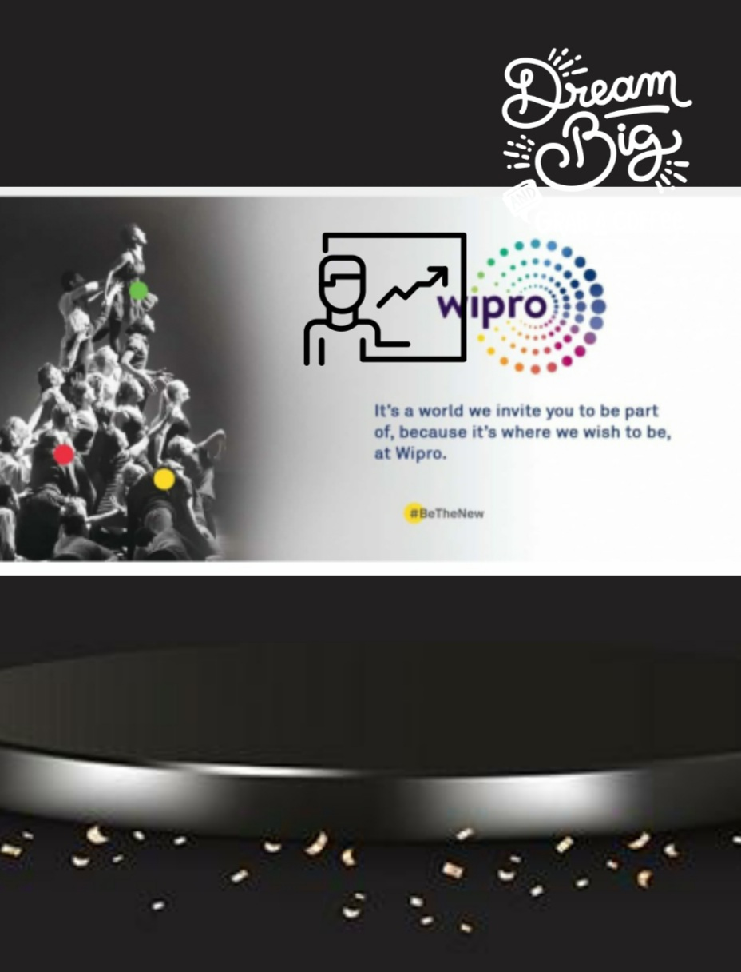
CONTENT CREATION AND CURATION
THE TEMPLATE THAT I CREATED FOR THE PROMOTION OF WIPRO :

Slide 31
CONTENT CREATION AND CURATION
Content Format 2: Client Success Stories
Research and Brainstorm: Share real-world examples of how Wipro has helped clients achieve their goals.
Global IT Solutions Content/Caption: "From Mumbai to New York, our IT solutions are making waves! Learn how we partnered with [Client] to streamline their global operations. #ITServices #GlobalSolutions" CTA: "Read the Success Story" or "Discuss Your Global IT Needs.“
Content Format 3: Employee Spotlights
Research and Brainstorm: Showcase the talented and dedicated people behind Wipro's success.

Slide 32
CONTENT CREATION AND CURATION
Meet Our AI Expert Content/Caption: "Meet [Employee Name], our AI wizard! 👩‍💻 Discover her journey and passion for pushing the boundaries of artificial intelligence. #TeamWipro #AIExpert" CTA: "Connect with [Employee Name]" or "Learn about AI Projects.“
CTA: "Watch the Tech Talk" or "Subscribe for More Insights."

Slide 33
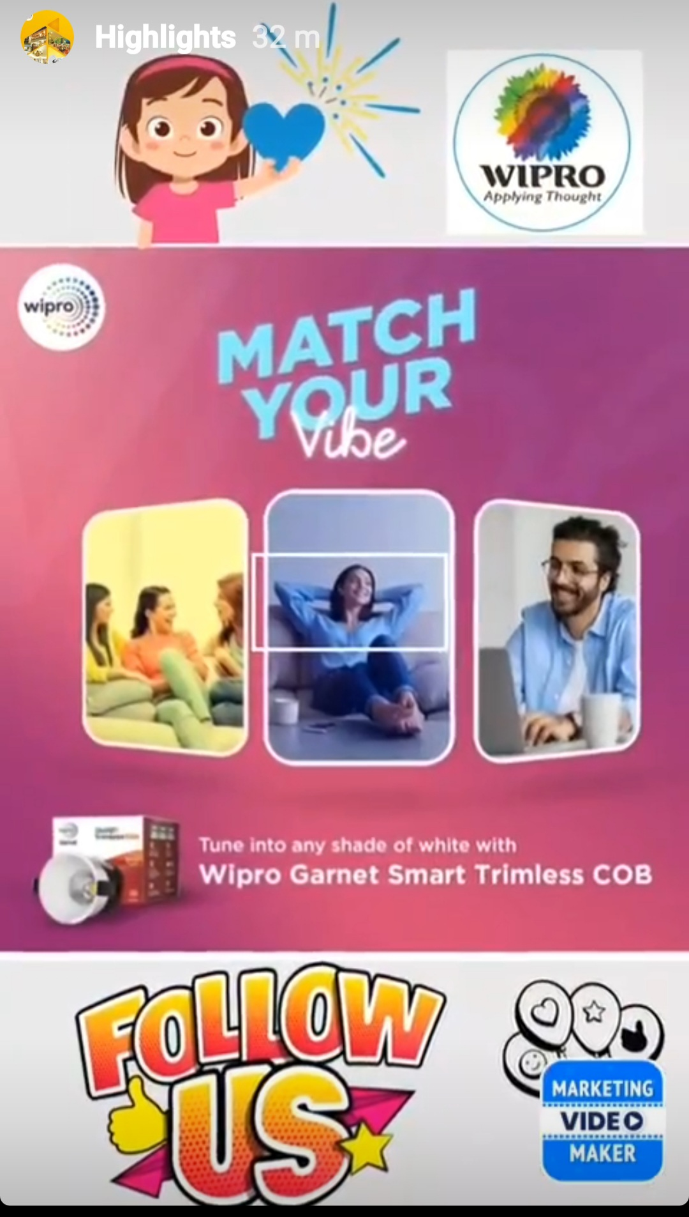
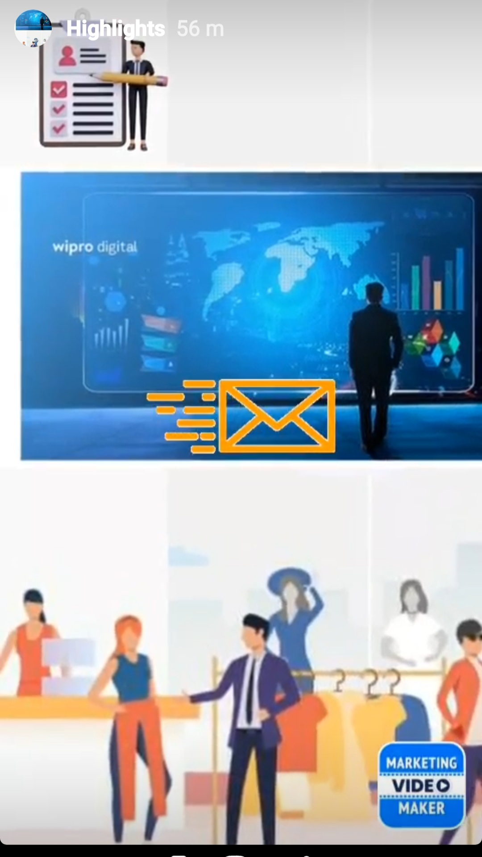
INSTAGRAM posts
THE STORIES FOR INSTAGRAM THAT I HAD CREATED FOR THE ADV
ERTISING OF WIPRO:

Slide 34
INSTAGRAM STORY
INSTAGRAM STORY:
https://www.instagram.com/s/aGlnaGxpZ2h0OjE4MDI3OTY0MDcyNjUwMjM4?story_media_id=3212581451777097105_62015320606&igshid=MzRlODBi
HIGHLIGHTS NAME : WIPRO TECH WORLD

Slide 35


